Slide 1
Bacterial Cell Structure

Slide 2
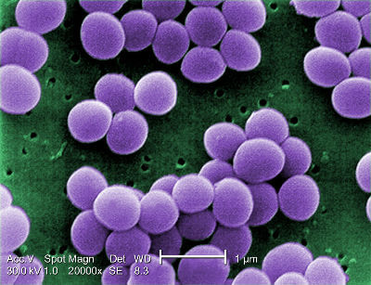
In this Smart Lesson, you will learn to:
1. | Understand that cells have specialised structures called organelles.
2. | Identify the organelles in a bacterial cell.
3. | Identify the function of those organelles.

Slide 3


Slide 4
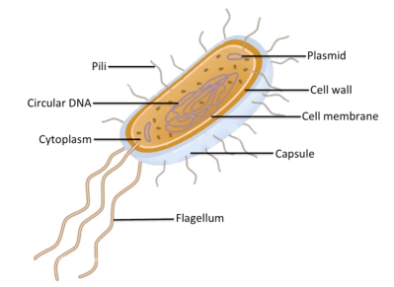
Although every species of bacteria looks slightly different, they all have the same basic structure.
A bacterial cell may have the following organelles (specialised structures):
- | Cell wall | - | Cell membrane
- | Capsule | - | Flagellum
- | Circular DNA | - | Pili
- | Ribosomes | - | Cytoplasm

Slide 5
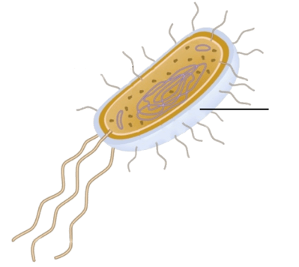
Most bacteria have a capsule, which is a thick, sticky covering that the cell uses for protection.
Eukaryotic cells do not have capsules, because they have other mechanisms for protecting themselves.

Slide 6
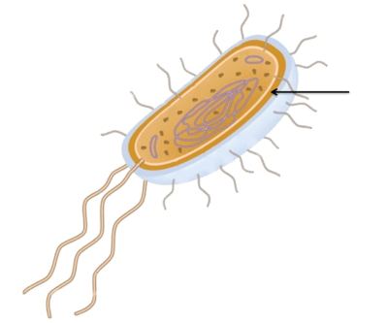
All bacteria have a cell wall which is a rigid layer surrounding the cell inside the capsule but outside the cell membrane.
It gives the cell structural support, helping to maintain its shape.
Not all eukaryotic cells have a cell wall. For example, plant and fungal cells have cell walls but animal cells do not.

Slide 7
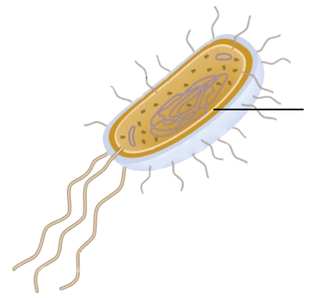
All bacteria have a cell membrane, which is a flexible layer surrounding the cell.
It separates the inside of the cell from the environment.
All cells, including eukaryotic cells, have a cell membrane. It is one of the most important parts of a cell. This is because it controls what goes into and out of the cell.

Slide 8
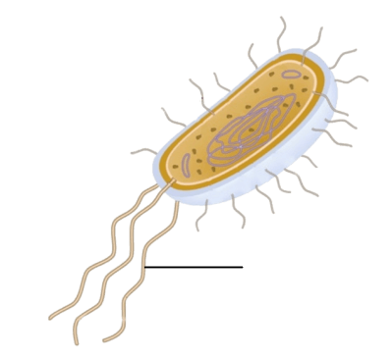
Some bacteria may have a flagellum (plural = flagella), a tail-like structure.
It is used to move around. These are incredible structures that are actually like tiny motors!
Some eukaryotic cells, such as sperm cells, have flagella to help them move.

Slide 9
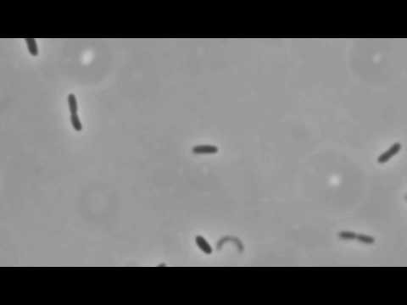

Slide 10
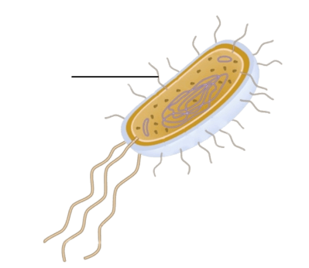
Some bacteria may have pili or fimbriae.
These are both hair-like extensions of the cell membrane that help the bacteria cling onto other cells and surfaces. Think of them like little extra arms!
Eukaryotic cells do not have pili or fimbriae.

Slide 11
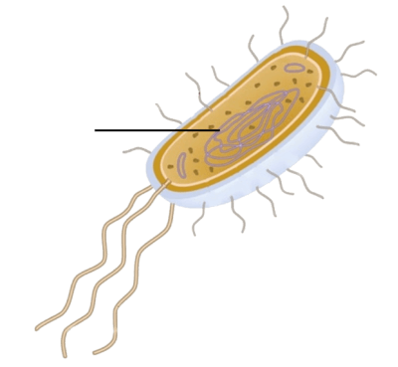
All bacteria have circular DNA.
In prokaryotes, genetic material (the instructions for the structure and functioning of the cell) is organised into one circular chromosome. In eukaryotes, it is organised into many linear chromosomes.

Slide 12
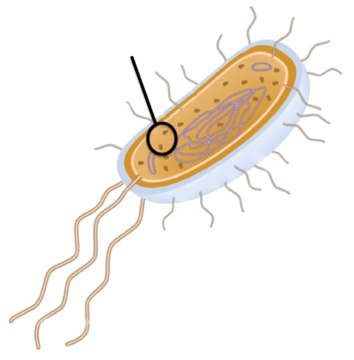
All bacteria have ribosomes.
These are large molecules that translate the instructions in the genetic material into proteins that make up the structure of the cell.
All cells, including eukaryotic cells, have ribosomes. They are very important, because all cells need proteins. Proteins make up most of the structures in a cell and help the cell to function efficiently.

Slide 13
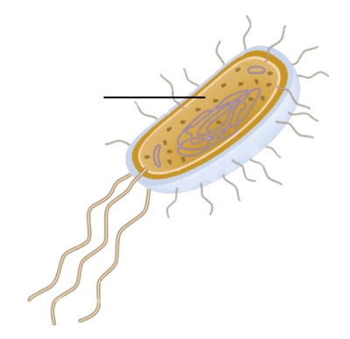
All bacteria have cytoplasm, a jelly-like substance inside the cell in which all the other cell contents float.
All cells, including eukaryotic cells, have cytoplasm. It holds the internal structures of the cell and allows substances to move around inside the cell.

Slide 14
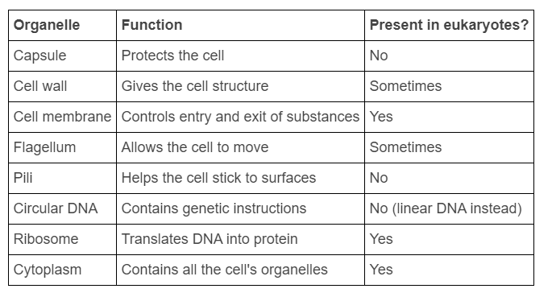
Bacterial organelles.
Here's a table to summarise the organelles that prokaryotic cells like bacteria may have, and whether eukaryotic cells also have them.

